Slide 1
COPYRIGHT & IPR IN DIGITAL AGE- ISSUES & CONCERNS FOR LIBRARIES
- L. Ashish Kumar
Assistant Professor
School of Law, GITAM

Slide 2
DIGITAL LIBRARIES
TRADITIONAL DIGITAL

Slide 3
ADVANTAGES OF DIGITAL LIBRARIES
Physical space savings
Ability to locate certain types of information much more quickly and efficiently
Simultaneous use of the same document by multiple users
More economic and time saving for users (Eg: Shift from photocopying to printing)

Slide 4
INTELLECTUAL PROPERTY RIGHTS
Copyright
Patent
Trade Mark
Industrial Design
Semiconductors Integrated Circuits
Geographical Indications
Plant Varieties
Trade Secrets

Slide 5

COPYRIGHT

Slide 6
The Berne Convention for the Protection of Literary and Artistic Works, 1886
Agreement on Trade Related Aspects of Intellectual Property Rights, 1994 (Article 9 to 14)
WIPO Internet Treaties
WIPO Copyright Treaty, 1996
WIPO Performances and Phonograms Treaty, 1996

Slide 7
Article 27 of UDHR
Everyone has the right freely to participate in the cultural life of the community, to enjoy the arts and to share in scientific advancement and its benefits.
(2) Everyone has the right to the protection of the moral and material interests resulting from any scientific, literary or artistic production of which he is the author.

Slide 8
Article 1 Section 8 of The Constitution of United States
“The congress shall have the power…..To promote the Progress of Science and useful Arts, by securing for limited Times to Authors and Inventors the exclusive Right to their respective Writings and Discoveries”.

Slide 9
ISSUES & CHALLENGES
Licenses
Contracts restricting the limitations and exceptions for libraries
Perpetual access
Preservation
Reproduction right and the safeguarding of the copies
Translation of works
Parallel importation

Slide 10
Digital Rights Management
Limitations on the liability of libraries
Rights of the disabled
RTI vs. Copyright (Dhaval Kumar Kiritkumar v. Director & 2……C/SCA/7232/2016)(Gujarat Hight Court)
Protection of databases (Eastern Book Co. & Ors. v. D.B. Modak & Anr.) (2008 1 SCC 1)

Slide 11
COPYRIGHT ACT, 1957
Section 65A: Protection of technological measures
Punishment which may extend to two years and shall also be liable to fine
Section 65B: protection of Rights Management Information
Punishment which may extend to two years and shall also be liable to fine/ Civil remedies

Slide 12
Section 52: Certain acts not to be infringement of copyright

Slide 13
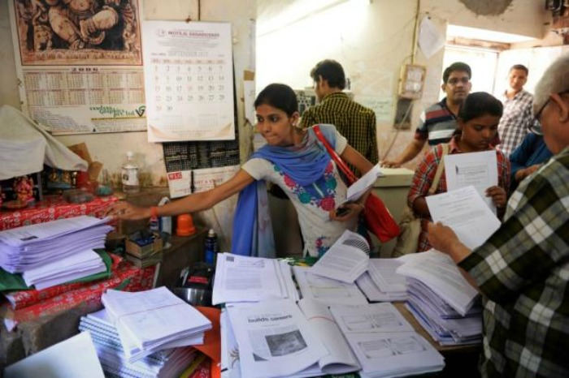
The Chancellor, Masters & Scholars of University of Oxford & Ors. v. Rameshwari Photocopy Services & Ors
{CS(OS) 2439/2012}

Slide 14
Is there a need for new legislation?

Slide 15
CONCLUSION
Legislating a justly balanced copyright system is a challenge. It must be acknowledged that it is a continuing process.
Legislators have to take a holistic approach and make rules that are sustainable in the long run and the law should be dynamic enough to adapt the digital shift.

Slide 16
THANK YOU

